Slide 1

Impact of youth gang involvement and gun Violence
By: Ashley Garber and Cynthia Rosales
Dr. Keiana Winters

Slide 2

join us in Step up, Step back

Slide 3
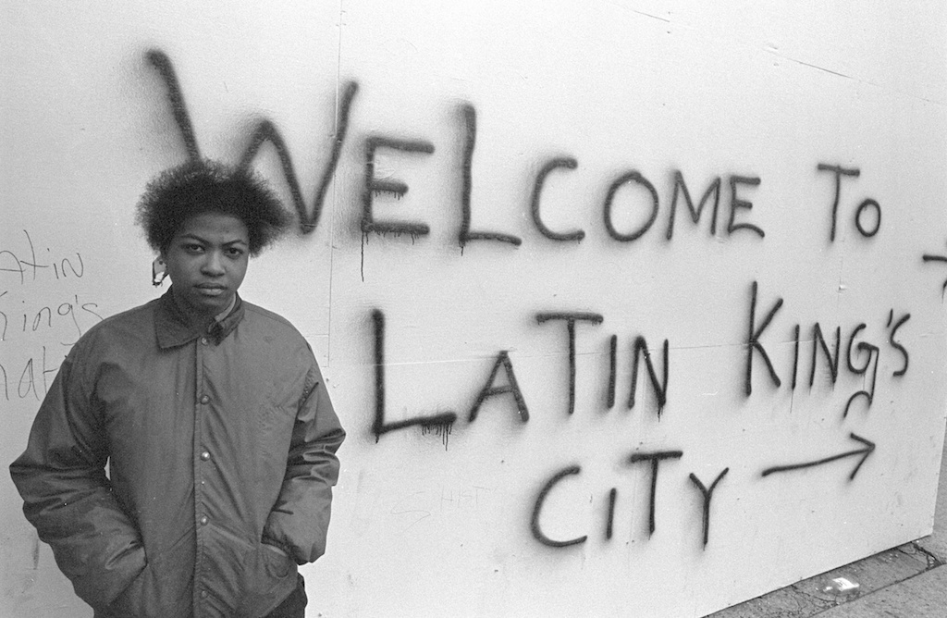
What is a gang?
A self-formed association of 3 or more people
Typically contains youth or young adults
Shares a common identity
Often engages in criminal activity, violence, or intimidation to increase power, reputation or economic resources
“ Gangs do not arise and people do not join gangs because of violence. People join gangs because of a lethal absence of hope.” – Father Greg Boyle via UCLA

Slide 4
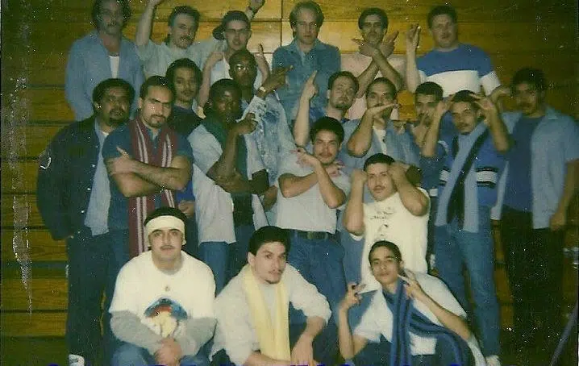
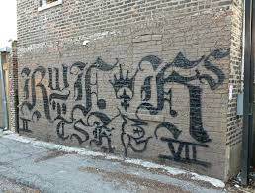
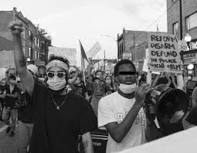
Gang History:
Two Rival alliances
Folk Nation
People Nation
Rival alliances were created in 1978.
People Nation was created first
Around 1919, Black gangs were formed to protect the community from white gangs who would terrorize them.
At the end of the 1950s, Hispanic gangs were created in Chicago
One of the first well-known street gangs was a white gang called the Gay lords that developed on the West side in 1952.

Slide 5
Latin Kings:
Originated in the Humboldt Park area of Chicago in 1954.
Eventually, the group grew to evolve to into a large criminal enterprise and shifting from original mission.
Latin King chapters are present nationwide, with an estimated 25,000 to 50,000 members residing in 34 states. Chicago police estimate that nearly 25,000 Latin King members reside within the Chicago area alone.
Founded by Ramon Santos originally as the "Imperials".
  Originally Puerto Rican Progress Movement targeted at overcoming racial discrimination and protecting against violence from other street gangs.

Slide 6
Latin Kings:
First 3 principles of the Latin Kings:
Protect our families
Protect our neighborhoods
Protect each other
June 12th, 1966 => Division Street Riots
Chicago Police shot Arcelis Cruz in Humboldt Park
Protest and riots ensued
Latin Kings joined the protests and riots. They would make the news nationally and globally.
Continued to fight against police brutality, crooked landlords and provide free lunches to children in the community

Slide 7
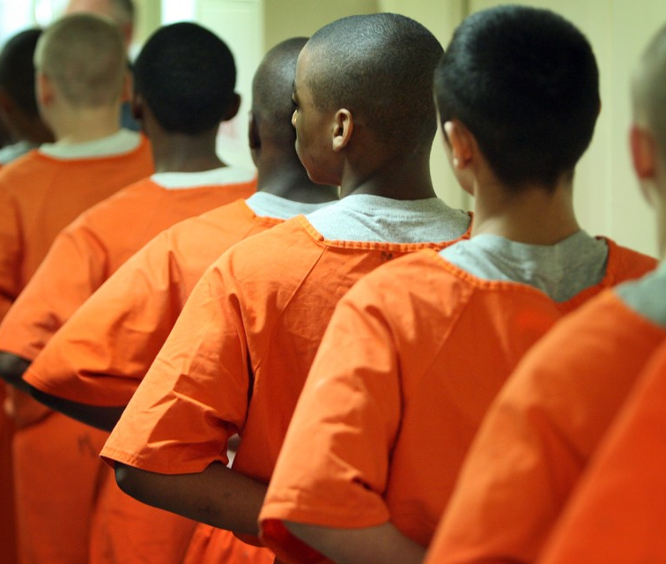
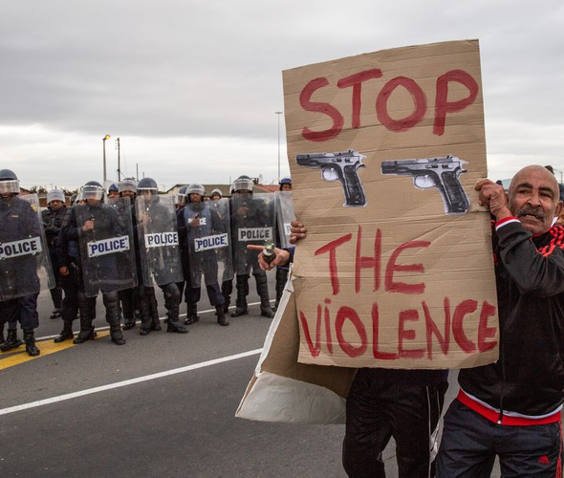
Gang Youth Stats:
The average age of a youth that joins a gang is approximately 13-14 years old. There have been some children as young as 8 or 9 to join.
More than 90% of the Chicago youth that were shooting victims in 2022 had either dropped out or were frequently absent from classes
According to the University of Chicago Crime Lab site: approximately 8% of Chicago homicides, 9% of shootings, 32% of robberies and 49% of carjackings were done by youth 17 and under (Vallas, 2023).
More than 92,000 Chicagoan youth between 16-19 were experiencing hardships on their career paths and frequently jobless in 2021.
Larger gangs in Chicago have become fractured
leading to more small gangs being youth led
new level of violence; specifically for territory/resources
Unaligned expectations with original gang principles
This Photo by Unknown Author is licensed under CC BY-NC
This Photo by Unknown Author is licensed under CC BY-ND

Slide 8
Gun violence:
The mental health consequences of interpersonal gun violence: A systematic review
By: Abba-Aji, M., Koya, S. F., Abdalla, S. M., Ettman, C. K., Cohen, G. H., & Galea, S.
Definition: The use or threatened use of a firearm that results in injury, death, or psychological harm to individuals or communities. This includes incidents such as homicide, suicide, accidental shootings, and assaults involving firearms.
Results found:
Exposure to interpersonal gun violence is linked to higher rates of PTSD, depression, and substance use.
Adolescents exposed to gun violence show more disruptive behaviors and are more likely to carry guns due to this.
Youth who are closer to the violence report greater negative mental health effects
Research is limited, with most studies focusing on a few mental health outcomes and primarily conducted in the U.S.

Slide 9
Mental HEALTH IMPACT
Trauma and PTSD: Direct exposure, such as witnessing a shooting or losing a loved one, frequently results in post-traumatic stress disorder (PTSD), fear, and depression.
Adolescent Impact: Youth exposed to gun violence often exhibit increased aggression, anxiety, and decreased concentration in school.
Gang-Involved Youth: Those involved in gangs suffer high rates of psychological distress due to chronic exposure to violent, life-threatening scenarios.
Mental Health and Behavior: While mental illness is not a primary driver of most violence, it can be a factor in suicides, which constitute a significant portion of gun deaths

Slide 10
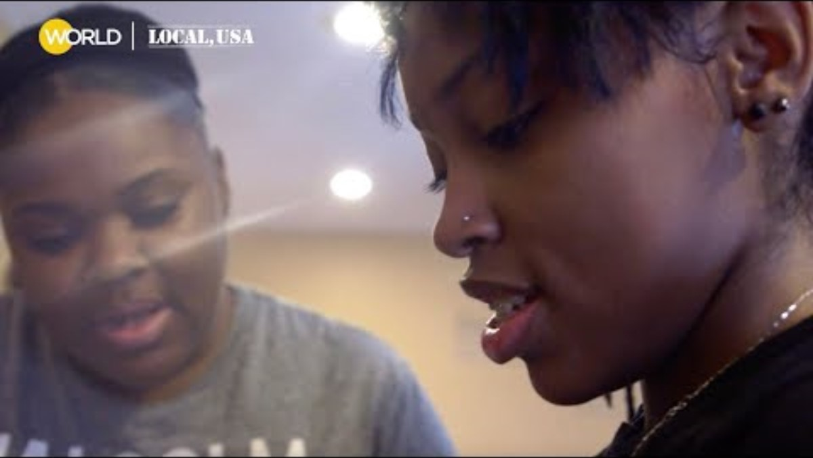
The Mental health impact on youth ; Gun violence

Slide 11

LETHAL MEANS SAFETY COUNSELING
Lethal means safety counseling is a voluntary, patient-centered health care intervention that prevents injury and death by helping patients and their families reduce access to lethal means for those at risk.
Lethal means are objects (e.g., firearms, sharp instruments, medications) that can be used to inflict self-harm or violence. Reducing access to lethal means, such as firearms, is an important part of a comprehensive approach to suicide prevention.

Slide 12
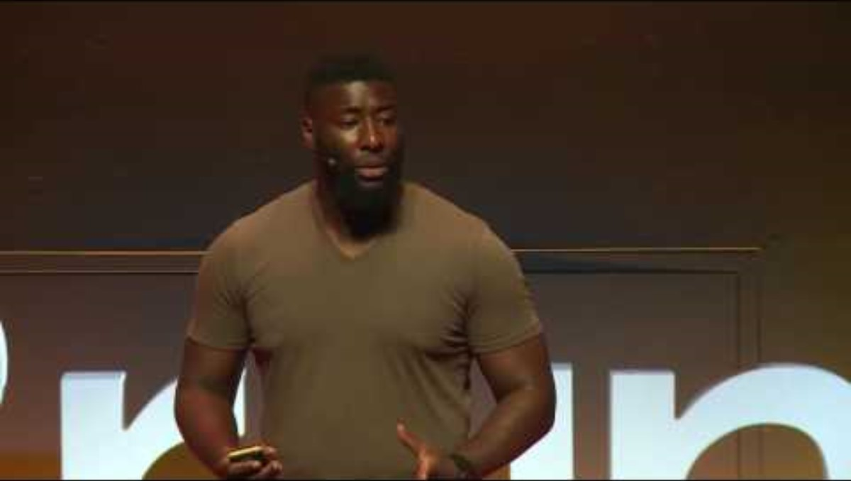
The real roots of youth violence | Craig Pinkney | TEDxBrum

Slide 13
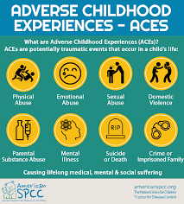
What are your Adverse Childhood Experiences?
Take the assessment!
Figure out your score!
Let’s discuss!

Slide 14
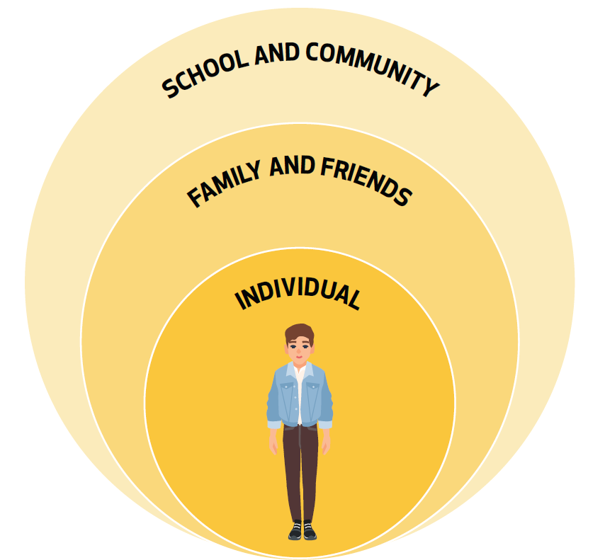
Risk Factors:
Individual
Family
Community
School and Peer influence

Slide 15
Individual:
The need for belonging/protection
Behavioral:
early involvement in delinquency
aggression
substance abuse
Self-esteem issues:
poor emotional connection
low self-esteem issues

Slide 16
Family:
Experiencing multiple caretaker transitions
Family gang involvement
having access to family members in gangs can significantly increase gang involvement
Poor parental involvement
lack of monitoring
inconsistent discipline
Family dysfunction
high-conflict households
lack of positive mentors or role models

Slide 17
School and Peer Influence:
"Too Cool for School? Violence, peer status, and high school dropout"
By: Jeremy Staff and Derek A. Kreager, Pennsylvania State University
Per the National Longitudinal Study of Adolescent Health, research-based evidence conducted shows that peer status in adolescence is highly associated with school achievement and adjustment.
  Found that disadvantaged boys with high status in violent groups are at much greater risks of high school dropout than other students.
Subculture theory of juvenile delinquency suggest that disadvantaged boys may gain peer status through violence, while membership in violent groups can negatively impact educational success.
Later findings fit well with subculture theories of juvenile delinquency as they suggest that violence and aggression provide means for disadvantaged boys to earn respect, prove their masculinity and meet peer expectations.

Slide 18

Community:
Limited Access to Resources:
high poverty neighborhoods often have less access to recreational programs, youth programs, good schools and mentorship programs. Youth may join a gang for better access to opportunities
Lack of Economic Opportunities:
- high poverty neighborhoods tend to have fewer job opportunities. This may lead youth to join gangs to create opportunities and financial freedom
Normalization of Violence:
In some neighborhoods, youth may experience daily violence. Youth may believe that joining a gang is a necessary part of survival.
Labeling/Stigmatization:
- If youth are continuously labeled as “criminals,” they have a tendency to internalize these labels and start to believe them. (label theory)

Slide 19

Community Cont.
Examples of labeling:
Clothing
Race
Neighborhood
Hair styles
Distrust of Law Enforcement:
Many youth feel that law enforcement will not protect them. This will increase the likelihood of joining gangs for protection
Youth believe that they must offer a sense of loyalty to the gang that the LE does not provide the community

Slide 20
Preventative Approaches:
Chicago Organizations:
Organizations such as Build Cred provide positive role models, especially for male youths.
Choose to Change (C2C) offers mentorship and uses CBT among their high-risk youth.
A study based around the C2C program exhibited a significant decrease of 39% of youth that were less likely to be arrested for violent crimes ( University of Chicago Crime lab, 2024).
These programs help at-risk youth establish healthy emotional regulation and create long-term goals

Slide 21
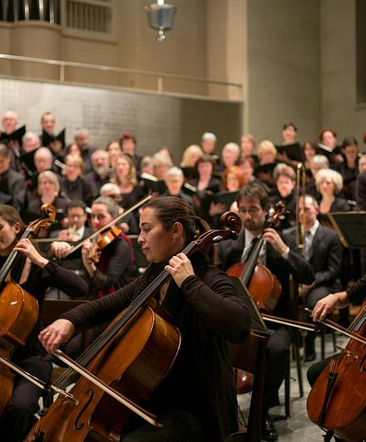
Preventative Approaches Cont.
Recreation and After-school Programs:
Establishing structured time can help decrease the amount of unmonitored time youth spends in the streets
These programs provide community support and allow youth to build healthy bonds
perfect example for an alternate for gang life
Examples:
Sports
Art and music programs
Community Centers
This Photo by Unknown Author is licensed under CC BY-NC-ND

Slide 22
Preventative Approaches Cont.
Family Economic Support:
These programs help reduce instability and allow parents to become more engaged with their children
Help parents have support for:
Childcare
Housing
Food
Employment/job training
Parent Skills Training:
These programs help parents learn to effectively communicate
Use appropriate conflict resolution
- Help parents set clear rules and boundaries within the family dynamic

Slide 23
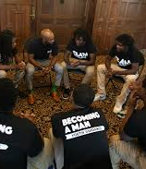
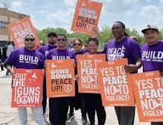
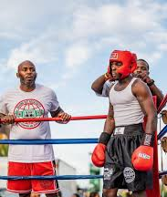
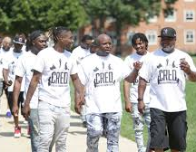
Resources:
https://www.buildchicago.org
https://www.boxingoutnegativity.org/about-us
https://www.kff.org/mental-health/the-impact-of-gun-violence-on-youth-mental-health-and-well-being/
https://www.enlacechicago.org/violenceprevention
https://www.chicagocred.org
https://www.formyblock.org
https://www.youth-guidance.org/bam-becoming-a-man/

Slide 24
Books to read:
The Boy who was Raised as a Dog by Bruce Perry
Discusses early trauma and how it can contribute to behavioral issues. These issues can lead to gang involvement
How gangs work: An Ethnography of Youth Violence by J. Densley
An in-depth study of how gang dynamics work
The New Jim Crow: Mass Incarceration in the Age of Colorblindness by Michelle Alexander
- Discusses the prison system’s part as modern day slavery. Also, this book touches on the war on drugs and how it disproportionately targets poverty-stricken communities, especially Black men. This book dives deep into the concept of how the criminal justice system uses new age Jim Crow laws to punish individuals and keep the cycle of racism alive.

Slide 25
Trainings:
National Gang Center (NGC)
https://nationalgangcenter.ojp.gov/webinars
Offers free webinars
Based around protecting youth from gangs/gang recruitment on social media
Addressing trauma
Outreach within the community and help from Law Enforcement
Gang Tool Kit
- Introduction to risk factors
Core strategies
Community outreach
Employment/job training

Slide 26
References:
Abba-Aji, M., Koya, S. F., Abdalla, S. M., Ettman, C. K., Cohen, G. H., & Galea, S. (2024). The mental health consequences of interpersonal gun violence: A systematic review. SSM – Mental Health, 5, 100302. https://doi.org/10.1016/j.ssmmh.2024.100302
Andriesen, P. (2023, August 30). The policy shop: Chicago’s youth violence problem. Illinois Policy. https://www.illinoispolicy.org/policy-shop/the-policy-shop-chicagos-youth-violence-problem/
Johns Hopkins Bloomberg School of Public Health, Center for Gun Violence Solutions. (n.d.). Lethal means safety counseling. https://publichealth.jhu.edu/center-for-gun-violence-solutions/lethal-means-safety-counseling (Bloomberg School of Public Health)
Leverso, J., & O’Neill, K. K. (2021, August 6). Youth gangs and victimization: An investigation of the impact of gang dynamics on experiences of victimization. Deviant behavior. https://pmc.ncbi.nlm.nih.gov/articles/PMC9512271/
Reveron, S. (2025, October 17). Almighty gang nation...Chicago gangs. CLVT Nation. https://cvltnation.com/almighty-gang-nation-chicago-gangs-photo-essay-more/
Risk factors. National Gang Center. (2020, December 16). https://nationalgangcenter.ojp.gov/spt/Risk-Factors
Robertson, K. (2018, October 17). Six things we learned from young adults experiencing gun violence in Chicago | urban institute. Urban Wire. https://www.urban.org/urban-wire/six-things-we-learned-young-adults-experiencing-gun-violence-chicago
Staff, J., & Kreager, D. A. (2008). Too cool for school? Violence, peer status, and high school dropout. Social Forces, 87(1), 445–471. https://doi.org/10.1353/sof.0.0068
Vallas, P. (2023, June 29). Vallas: Chicago teens are dying, committing more crimes: Work-study can fix that. Illinois Policy. https://www.illinoispolicy.org/vallas-chicago-teens-are-dying-committing-more-crimes-work-study-can-fix-that/#:~:text=Violence%20against%2C%20and%20committed%20by,than%20the%20average%20Chicago%20resident.
Youth violence. University of Chicago Crime Lab. (2025, December 15). https://crimelab.uchicago.edu/topics/youth-supports/

