Slide 1
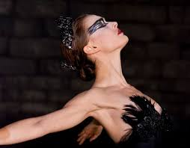
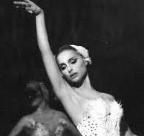
Nina Sayers
Emma Paulson
Ashley Garber
November 5th, 2025

Slide 2

Client Demographics:
A: 28 years old
D: No known physical disabilities
D: No known mental disabilities
R: No known religion
E: White/Caucasian
S: Middle-Class
S: Heterosexual
I: No known indigenous heritage
N: American
G: Female

Slide 3
Presenting Problem:
Nina reports an increasing issue with anxiety surrounding performing. She is currently practicing for the main role in "The Black Swan." This has created an increased pressure to be perfect, especially learning how to portray the innocence and sensuality of both swans. Nina not only experiences immense pressures in the studio, but at home. She is afraid she will not be able to meet her mother's expectations. Nina reports feeling a deep fear of failure when it comes to people in her life, specifically centered around her mother and director. This has created a poor self-image issue and poor boundaries for Nina. She has also reported that she's been experiencing visual and auditory hallucinations. One last thing to note, Nina also has some confusion centered around her sexual identity, which has been impacted due to the increased pressure she has been experiencing.

Slide 4
History:
Nina was raised and lives with a very overprotective and controlling mother, who projects her own failed ballerina dreams onto her. There is no known father figure. Her childhood was highly structured, focused strictly on ballerina training, very little emotional freedom and normal peer socialization. She has difficulty expressing her anger and sexuality. She seeks approval from people in position of power.
There is no mention of prior mental health treatment or psychiatric history. No evidence of substance use or abuse.

Slide 5
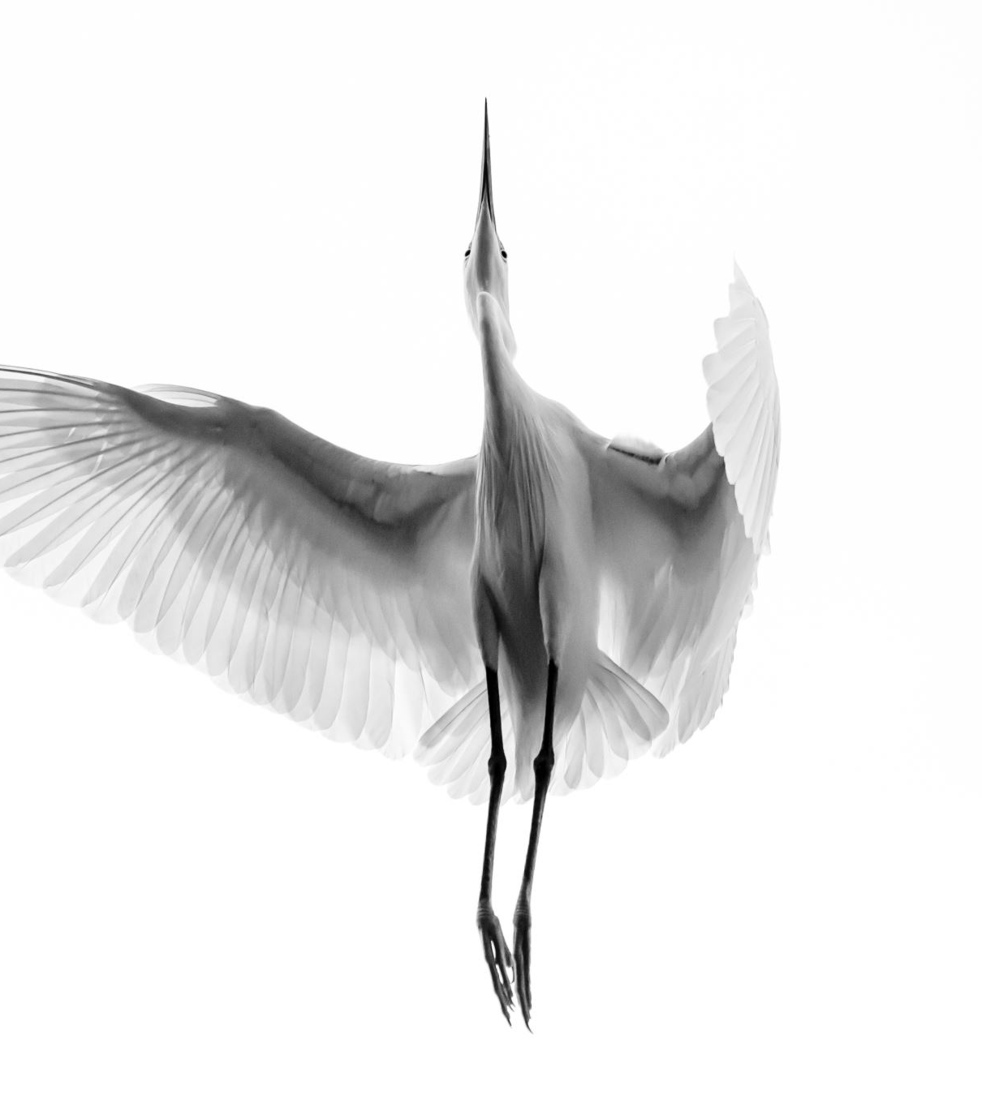
Symptoms
Delusions: Believes Lily is trying to sabotage and replace her
Hallucinations: Seeing herself transform into the black swan, feeling feathers grow from her skin, and auditory distortions
Disorganized behaviors: Erratic emotional responses, confusion between fantasy and reality, self-injury during hallucinations
Perfectionism and control: the need to perform flawlessly, she obsesses over every move
Fear of failure: Thoughts of being replaced by Lily.
Body-Focuses obsessions: Preoccupies about her nails, skin, and injuries
Skin picking
Nail biting

Slide 6
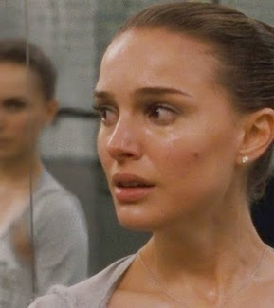
Symptoms Continued
Repetitive rehearsals and checking: constantly practices movements and checks her looks in the mirror to make sure she looks perfect.
Rigid rules and routines: Maintains strict daily rules for eating, practicing, and self-care
Inflexible: Has trouble accepting feedback or improvising
Avoidance

Slide 7

Additional Associated Symptoms:
Child-like behavior (regression)
Nausea
Racing thoughts
Constant worry
Excessive exercise

Slide 8
Strengths:
Dedication
Work ethic
Discipline
Ambitious
Goal-oriented

Slide 9
Barriers:
Crippling perfectionism
Paranoia
Relationship with Mother
Extreme competitive environment
Difficulty with control
Insecurities

Slide 10
Diagnoses
Psychosis
OCD
Eating Disorder

Slide 11
Treatment Modality
Immediate Stabilization
2. Individual client sessions
3. Group therapy
4. Family therapy sessions

Slide 12
Stabilization:
Nina needs a full medical evaluation to ensure there are no other underlying causes for her condition
Her delusions and hallucinations need to be stabilized.
An anti-psychotic medication should be administered to help mitigate her delusions and hallucinations
Once Nina is stabilized, long-term treatment planning can occur

Slide 13
Individual/Family Sessions:
60 minutes for 3 months ( 13 weeks)
Sessions will be once a week
Towards the 3-month mark, Nina and I will discuss how she feels and what to do moving forward.
Family sessions will be 50 minutes for 3 months (13 weeks)
These sessions will occur once a week as well
This will only be recommended if Nina feels it will benefit her

Slide 14
Group Sessions:
Overcoming Perfectionism Group Therapy
Eating Disorder Peer Support Group
Daughters with Difficult Mothers (virtual)
People struggling with Paranoia or Delusions

Slide 15
Treatment Plan
Goal 1: I want to stabilize my psychotic symptoms
  Objective 1: Nina will get a psychiatric evaluation to assess the need for medication
    Intervention 1: Talk with psychiatrist for any antipsychotic medication and future medication monitoring
  Objective 2: Nina will develop and use grounding techniques to distinguish between hallucinations and reality
    Intervention 2: Be taught mindfulness and grounding exercises in group/individual therapy
Goal 2: I want to reduce my anxiety and perfectionist thinking
  Objective 1: Nina will learn to identify triggers of performance-related anxiety and perfectionism
    Goal 1: Develop a stress management plan for high-performance situations
  Objective 2: Nina will practice at least two coping strategies to manage stress
    Goal 2: Will learn and practice a balanced routine to prevent exhaustion

Slide 16
Treatment Plan Continued
Goal 3: I want to stabilize my eating patterns and restore balanced nutrition
  Objective1 : Nina will normalize her eating schedule
    Intervention 1: Nutrition counseling and a meal plan coordinated with a registered dietitian
  Objective 2: Reduce body checking
    Intervention 2: Limit exposure to mirrors and cover mirrors when eating

