Slide 1

Blue Crescent Treatment
Ashley Garber
Peter Giannopoulos
Emma Paulson
Cynthia Rosales
ThePhoto by PhotoAuthor is licensed under CCYYSA.

Slide 2
At our addictions therapy site serving low-SES populations, community support includes partnerships with local sober living programs, workforce development centers, food pantries, legal aid, Medicaid, and AA/NA/GA. Clients are referred to peer recovery meetings and linked to case managers who help secure healthcare. Our site also collaborates with a nearby community college to help clients enroll in certificate programs that promote independence and stability post-recovery.

Slide 3
Community Support
AA/NA/smart recovery
Sober living house
Workforces development centers; PLCCA, NAMI
Medicaid
Legal aid societies, re-entry programs
Notes:
Offers accountability, belonging, and modeling of sober living,
Workforce development centers, job readiness training, GED or community college programs
Builds self-efficacy and reduces economic stressors linked to relapse
SNAP, Medicaid, transportation vouchers, childcare subsidies
Addresses basic needs that allow focus on recovery
Re-entry programs, legal aid societies, expungement clinics
Reduce barriers to employment and housing

Slide 4
Why is Community Support Important?
Reduces isolation: Low-SES individuals often face limited family or financial support. Community networks help rebuild connection.
Improves long-term outcomes: Research shows recovery capital (social, physical, and cultural resources) predicts sustained sobriety.
Bridges treatment and real life: Clients can continue support after discharge, preventing relapse.
Promotes empowerment: Access to resources restores autonomy and dignity.

Slide 5

Mental Health
Interventions
&
Techniques
Group Therapy
Individual Therapy
Psychiatric Medication Management
Psychoeducation

Slide 6
Mental Health Interventions & Techniques:
Group Therapy
Group Therapy: A form of treatment where individuals with similar issues meet together in a group setting with one or more therapists to share experiences, provide mutual support, and develop coping skills in a safe and structured environment.
Benefits of group therapy:
Peer Support and Accountability: A sense of understanding from others going through similar experiences.
Accountability and Modeling: Seeing peers make progress in recovery can inspire hope and motivation. Clients can learn practical coping skills from others who may be further along in their sobriety journey.
Safe Space: Provides a supportive environment to process emotions, triggers, and relapses without judgment, helping clients develop trust and emotional openness.
Interventions:
Relapse Prevention Groups
Support Groups
CBT and DBT Groups

Slide 7
Mental Health Interventions & Techniques:
Individual Therapy
Individual Therapy: A form of treatment where the client can meet one-on-one with a licensed counselor / clinician who promotes healing and fosters a therapeutic environment and space that focuses on exploring thoughts, emotions, and behaviors to promote personal growth, coping skills, and overall emotional well-being.
Benefits of individual therapy:
Personalized Support: Professional support that focuses on the client’s unique experiences that provides understanding, validation, and guidance to help promote personal growth and recovery.
Coping Skill Building and Motivation: Clients learn coping skills to help manage difficult or uncertain challenges in their daily lives while also reinforcing motivation by recognizing their own personal achievements in their recovery journey in individual therapy.
Interventions:
Cognitive Behavioral Therapy
Dialectical Behavioral Therapy
EMDR - By targeting the underlying traumatic experiences that often contribute to substance abuse, EMDR aims to alleviate the psychological distress that fuels addiction

Slide 8
Mental Health Interventions & Techniques:
Psychiatric Medication Management
Psychiatric Medication Management: A treatment approach where clients meet with a licensed psychiatrist or nurse practitioner to assess, prescribe, and monitor medications that support mental health, manage substance or alcohol use, monitor for any withdrawal symptoms and promote overall stability.
Benefits of Psychiatric Medication Management:
Symptom and Craving Management: Helps reduce mental health symptoms and manage cravings associated with substance or alcohol use.
Collaborative Care: Encourages coordination between prescribers, therapists, and other providers for comprehensive treatment.
Education and Empowerment: Clients learn about their medications, side effects, and the importance of consistency to support recovery.
Interventions:
Medication Evaluation and Monitoring
Psychoeducation on Medication
Integrated Care Approach – Combines medication with therapy and support services to promote long-term recovery and sobriety and emotional wellness.

Slide 9
Mental Health Interventions & Techniques:
Psychoeducation
Psychoeducation: Opportunity for clients and at times their families and supports are provided with information about mental health, substance or alcohol use, and recovery strategies to increase understanding and promote healthier decision-making to promote sobriety.
Benefits of Psychoeducation:
Knowledge and Awareness: Helps clients understand their disorder , triggers, and the effects of substance or alcohol use.
Improved Coping Skills: Teaches strategies to manage symptoms, cravings, and high-risk situations.
Family and Social Support: Educates families to provide supportive, informed care and reduces stigma.
Interventions:
Workshops and Educational Sessions: Focused on understanding addiction, mental health, and recovery.
Relapse Prevention Education – Teaches clients to be able to identify their triggers and implement strategies to maintain sobriety.

Slide 10
Medical Community Integration:
Purpose of Integration
Ensure clients receive coordinated behavioral and physical healthcare to support long-term recovery
Recognizing that untreated medical conditions and unmanaged withdrawal symptoms can limit engagement in counseling and within the counseling space
Networking Opportunities
Primary Care providers- routine checkups, chronic condition management
Addiction Therapists-medication stabilization, monitoring and assessment assigning to ensure efficient and personalized care.
Psychiatrists/Prescribers- mental health medication management for co-occuring disorders
Hospitals/Detox Units- coordinated discharge planning to prevent relapse after stablization
Collaboration Approach
Warm hand-offs to prevent clients from "falling through the cracks" and staying true with treatment goals.
Shared treatment planning with signed releases for ROI's
Health and behavioral staff to meet in regular group staffings and supervision meetings.

Slide 11
Medical Community Integration:
Medications Utilized in the Program:
Suboxone
Helps reduce cravings and withdrawal symptoms so clients can focus on daily functioning and treatment goals
Methadone
Provides a long-acting stabilization option, especially for individuals with a long history of opioid use or significant physiological dependence.
Vivitrol
Blocks the effects of opioids and reduces alcohol cravings and supporting relapse prevention and long term maintenance

Slide 12
Medical Community Integration:
Ongoing Health Monitoring
Full health assessments at intake and throughout care
Screenings provided for most major health issues and stabilization
Medication compliance monitoring and side-effect tracking.
Care Coordination Model
Ensure consistency across medical and behavioral services
Detect early warning signs of relapse or medical decline
Support transitions between detox, outpatient care, hospitalization and community reintegration.
Psychoeducation around medication expectations and relapse risk.
Core Rationale
When clients are medically stabilized and physically supported, they are more capable of emotional regulation, participation in therapy and sustaining long-term recovery.

Slide 13

Ethical Concerns:
Informed consent
Stigma and bias
Confidentiality
Client impairment
Professional boundaries

Slide 14
Diversity and Multicultural issues:
Masculinity
Stigma
Peer pressure
Family dynamics
Cultural differences

Slide 15
Law Engagement:
Pros:
Cons:
Accountability
Routine
Structure
Access to treatment
Community
Decrease in incarceration
Poor engagement
Stigma
Criminalization
Coercion and lack of autonomy
Focus on punishment vs rehabilitation

Slide 16
Angel Programs:
Also known as "safe stations"
Aims to connect community, law enforcement and substance facilities
Allows for individuals struggling with addiction to seek help
Helps reduce recidivism and improve life outcome

Slide 17
Overdose Training:
Educating individuals on the signs of an overdose
Providing insight into post-overdose care
Training in a shared space that allows for a sense of community; gaining an understanding of each other's experience in the field
Psychoeducation on harm reduction

Slide 18
Court Mandated:
A treatment plan is put together by a multidisciplinary team
The plan may include a combinations of things, including detox, support groups
The client's participation is monitored through various activites (random drug testing, court hearings.)
This is another program that reduces recidivism

Slide 19

LEAD:
Law Enforcement Assistant Diversion Program
Community-based program where officers can refer those with low-level, non-violent offense for treatment
LEAD covers drug treatment, mental health intervention, and employment
This program address the root cause of the addiction
Helps reduce recividism

Slide 20
Social Justice Concerns:
Lower socioeconomic status
Language barriers
Stigma/labeling
Discrimination

Slide 21
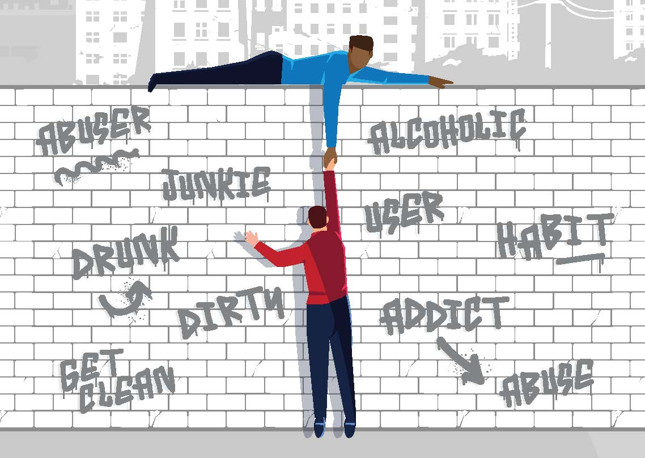
Just a reminder:

